Slide 1

Decision and Regression Trees
Applied Machine Learning Derek Hoiem
Dall-E: A dirt road splits around a large gnarly tree, fractal art

Slide 2
Logistics
More course staff introductions
Josh Levine (TA)
Kshitij Phulare (TA)
Pedro Cisneros (Post-doc Course Assistant)
All course materials: https://courses.engr.illinois.edu/cs441/sp2023/
See CampusWire for Office Hours
Survey by email
Will spend some time going over key concepts Thursday

Slide 3
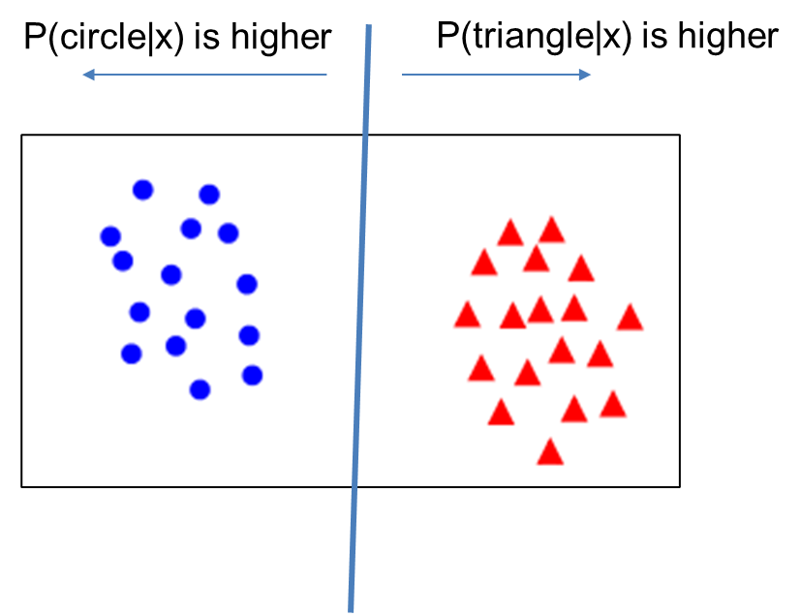
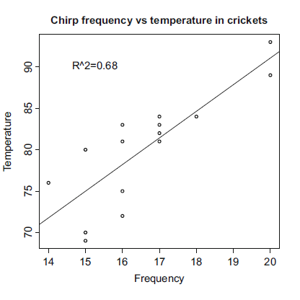
Things to remember (from Thurs)
Linear logistic regression fits a linear model to predict a logit value indicating likelihood of each class
Linear regression fits a linear model to a set of feature points to predict a continuous value
Explain relationships
Predict values
Extrapolate observations
Nearest neighbor and linear models are the final predictors of most ML algorithms – the complexity lies in finding features that work well with NN or linear models

Slide 4
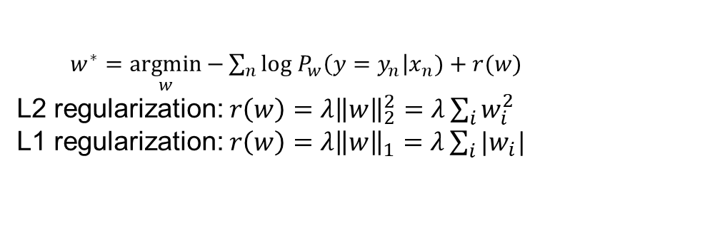
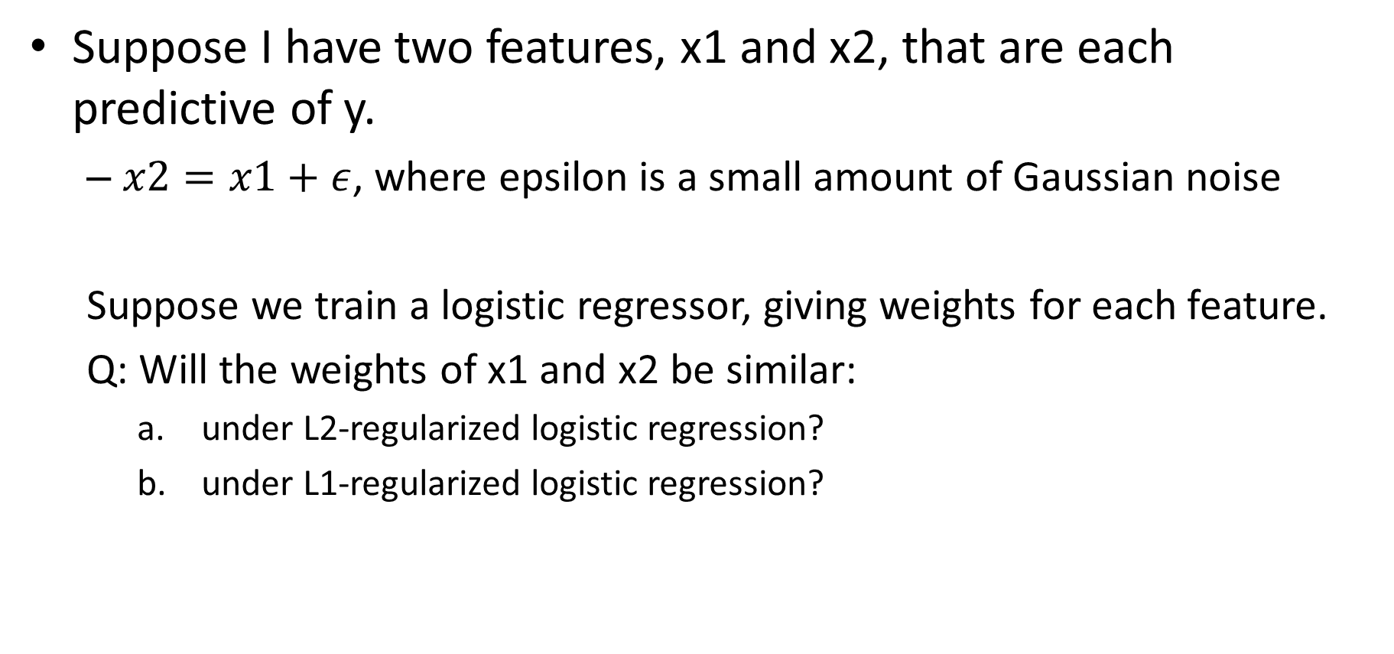
Logistic regression review question
Suppose I have two features, x1 and x2, that are each predictive of y.
$x2=x1+ε$, where epsilon is a small amount of Gaussian noise
Suppose we train a logistic regressor, giving weights for each feature.
Q: Will the weights of x1 and x2 be similar:
under L2-regularized logistic regression?
under L1-regularized logistic regression?
$w^{∗}=\underset{w}{argmin}{−\sum_{n}{log P_{w}\left(y=y_{n}\right|x_{n})+r(w)}}$
L2 regularization: $r\left(w\right)=λ{\left\|w\right\|}_{2}^{2}=λ\sum_{i}{w_{i}^{2}}$
L1 regularization: $r\left(w\right)=λ{\left\|w\right\|}_{1}=λ\sum_{i}{|w_{i}|}$

Slide 5
Recap of previous lectures
Nearest neighbor is widely used
Super-powers: can instantly learn new classes and predict from one or many examples
Naïve Bayes represents a common assumption as part of density estimation, more typical as part of an approach rather than the final predictor
Super-powers: Fast estimation from lots of data; not terrible estimation from limited data
Logistic Regression is widely used
Super-powers: Effective prediction from high-dimensional features; good confidence estimates
Linear Regression is widely used
Super-powers: Can extrapolate, explain relationships, and predict continuous values from many variables
Almost all algorithms involve nearest neighbor, logistic regression, or linear regression
The main learning challenge is typically feature learning

Slide 6
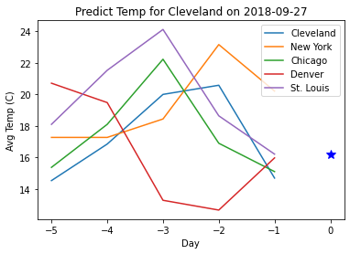
HW 1 summary
MNIST Digit Classification
Predict label (0-9) from pixel intensities (784x1 vector)
Implement and test KNN, Naïve Bayes, Linear Logistic Regression
Plot Error vs Training Size
Select best parameter using validation
Temperature Regression
Predict Cleveland’s next day temperature from recent temperatures of US cities
Implement and test KNN, Naive Bayes (NB), and Linear Regression (LR)
Identify most important features with L1 linear regression, and re-train/evaluate with most important features
Stretch Goals
Improve MNIST Classification
Improve Temperature Regression
Generate a train/test classification dataset in which Naive Bayes outperforms 1-NN and Logistic Regression

Slide 7
Completing HWs
Read assignment and tips
Code by adding to starter code notebook (which mainly has data loading and visualization functions)
Complete report, including expected points
Submit the report, notebook pdf/html, and zip/ipynb code
Mainly grader will look at report first, notebook pdf for clarification, and run code rarely
Notebook does not need to include all outputs

Slide 8
So far, we’ve seen two main choices for how to use features
Nearest neighbor uses all the features jointly to find similar examples
Linear models make predictions out of weighted sums of the features
If you wanted to give someone a rule to split the ‘o’ from the ‘x’, what other idea might you try?
x
x
x
x
o
o
o
x
o
o
o
o
x
x2
x
x
x
x1
If x2 < 0.6 and x2 > 0.2 and x2 < 0.7, ‘o’
Else ‘x’
Can we learn how to make these kinds of rules automatically?

Slide 9
Decision trees
Training: Iteratively choose the attribute and split value that best separates the classes for the data in the current node
Combines feature selection/modeling with prediction
Fig Credit: Zemel, Urtasun, Fidler

Slide 10
Decision Tree Classification
Slide Credit: Zemel, Urtasun, Fidler

Slide 11
Example with discrete inputs
Slide Credit: Zemel, Urtasun, Fidler

Slide 12
Example with discrete inputs
Figure Source: Zemel, Urtasun, Fidler

Slide 13
Decision Trees
Figure Source: Zemel, Urtasun, Fidler

Slide 14
Decision tree algorithm
Training
Recursively, for each node in tree:
If labels in the node are mixed:
Choose attribute and split values based on data that reaches each node
Branch and create 2 (or more) nodes
Return
x
x
x
o
x
x
x
o
x
o
x
o
o
o
o
x2
x1

Slide 15
Decision tree algorithm
x2 < 0.6
y
n
Training
Recursively, for each node in tree:
If labels in the node are mixed:
Choose attribute and split values based on data that reaches each node
Branch and create 2 (or more) nodes
Return
1
x
x
x
o
x
x
x
o
x
o
x
o
o
o
o
x2
(0,0)
x1
1

Slide 16
Decision tree algorithm
x2 < 0.6
y
n
x1 < 0.7
Training
Recursively, for each node in tree:
If labels in the node are mixed:
Choose attribute and split values based on data that reaches each node
Branch and create 2 (or more) nodes
Return
o
x
1
x
x
x
o
x
x
x
o
x
o
x
o
o
o
o
x2
(0,0)
x1
1

Slide 17
Decision tree algorithm
x2 < 0.6
y
n
x1 < 0.7
x2 < 0.8
Training
Recursively, for each node in tree:
If labels in the node are mixed:
Choose attribute and split values based on data that reaches each node
Branch and create 2 (or more) nodes
Return
o
x
x
1
x
x
x
o
x
x
x
o
x
o
x
o
o
o
o
x2
(0,0)
x1
1

Slide 18
Decision tree algorithm
x2 < 0.6
y
n
x1 < 0.7
x2 < 0.8
Training
Recursively, for each node in tree:
If labels in the node are mixed:
Choose attribute and split values based on data that reaches each node
Branch and create 2 (or more) nodes
Return
o
x
x
x1 < 0.4
x
x1 < 0.5
o
x
1
x
x
x
o
x
x
x
o
x
o
x
o
o
o
o
x2
(0,0)
x1
1

Slide 19
Decision tree algorithm
x2 < 0.6
y
n
Prediction
Check conditions to descend tree
Return label of leaf node
x1 < 0.7
x2 < 0.8
o
x
x
x1 < 0.4
x
x1 < 0.5
o
x
x
x
x
o
x
x
*
x
*
o
x
o
x
o
o
o
o
x2
(0,0)
x1
1

Slide 20
How do you choose what/where to split?
Slide Source: Zemel, Urtasun, Fidler

Slide 21
Quantifying Uncertainty: Coin Flip Example
Slide Source: Zemel, Urtasun, Fidler

Slide 22
Quantifying Uncertainty: Coin Flip Example
Slide Source: Zemel, Urtasun, Fidler

Slide 23
Quantifying Uncertainty: Coin Flip Example
Entropy:
Slide Source: Zemel, Urtasun, Fidler

Slide 24
Entropy of a Joint Distribution
Slide Source: Zemel, Urtasun, Fidler

Slide 25
Specific Conditional Entropy
Slide Source: Zemel, Urtasun, Fidler

Slide 26
Conditional Entropy
Slide Source: Zemel, Urtasun, Fidler

Slide 27
Conditional Entropy
Slide Source: Zemel, Urtasun, Fidler

Slide 28
Conditional Entropy
Slide Source: Zemel, Urtasun, Fidler

Slide 29
Information Gain
Slide Source: Zemel, Urtasun, Fidler

Slide 30
Constructing decision tree
Training
Recursively, for each node in tree:
If labels in the node are mixed:
Choose attribute and split values based on data that reaches each node
Branch and create 2 (or more) nodes
Return
Measure information gain
For each discrete attribute: compute information gain of split
For each continuous attribute: select most informative threshold and compute its information gain. Can be done efficiently based on sorted values.
Select attribute / threshold with highest information gain

Slide 31
Constructing Decision Trees
Slide Source: Zemel, Urtasun, Fidler

Slide 32
Constructing Decision Trees
Slide Source: Zemel, Urtasun, Fidler

Slide 33
Pause, stretch, and think: Is it better to split based on type or patrons?
Slide Source: Zemel, Urtasun, Fidler

Slide 34
Slide Source: Zemel, Urtasun, Fidler

Slide 35

What if you need to predict a continuous value?
Regression Tree
Same idea, but choose splits to minimize sum squared error $\sum_{n∈node}{{\left(f_{node}\left(x_{n}\right)−y_{n}\right)}^{2}}$
$f_{node}\left(x_{n}\right)$ returns the average prediction value of data points in the leaf node containing $x_{n}$

Slide 36
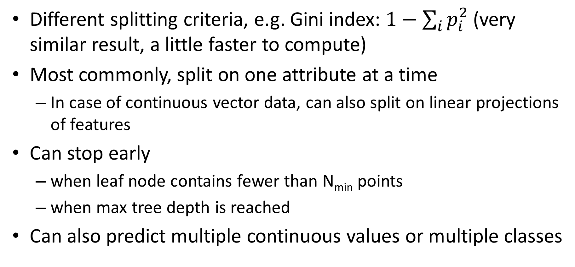
Variants
Different splitting criteria, e.g. Gini index: $1−\sum_{i}{p_{i}^{2}}$ (very similar result, a little faster to compute)
Most commonly, split on one attribute at a time
In case of continuous vector data, can also split on linear projections of features
Can stop early
when leaf node contains fewer than N_{min} points
when max tree depth is reached
Can also predict multiple continuous values or multiple classes

Slide 37
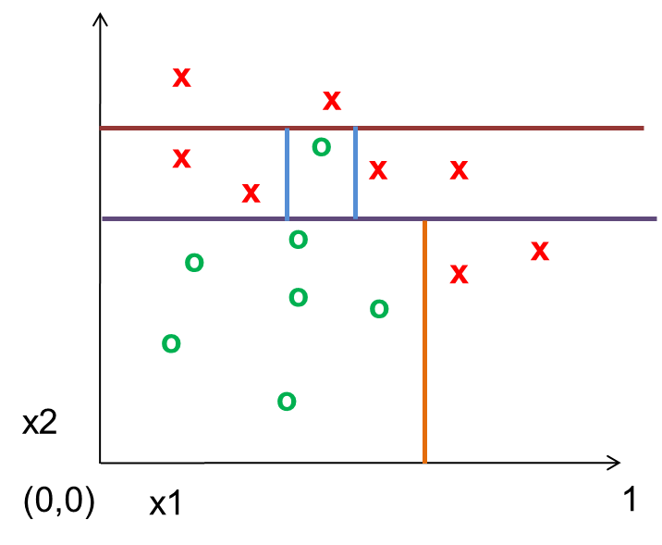
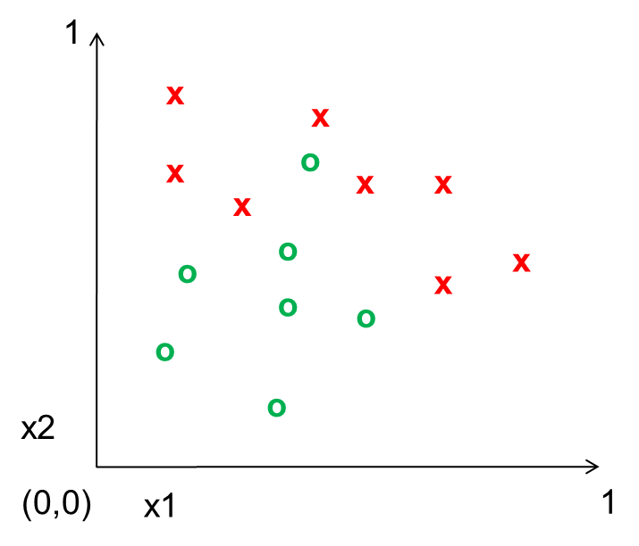
Decision Tree vs. 1-NN
DT Boundaries
Both have piecewise-linear decisions
Decision tree is typically “axis-aligned”
Decision tree has ability for early stopping to improve generalization
True power of decision trees arrives with ensembles (lots of small or randomized trees)
1-NN Boundaries

Slide 38
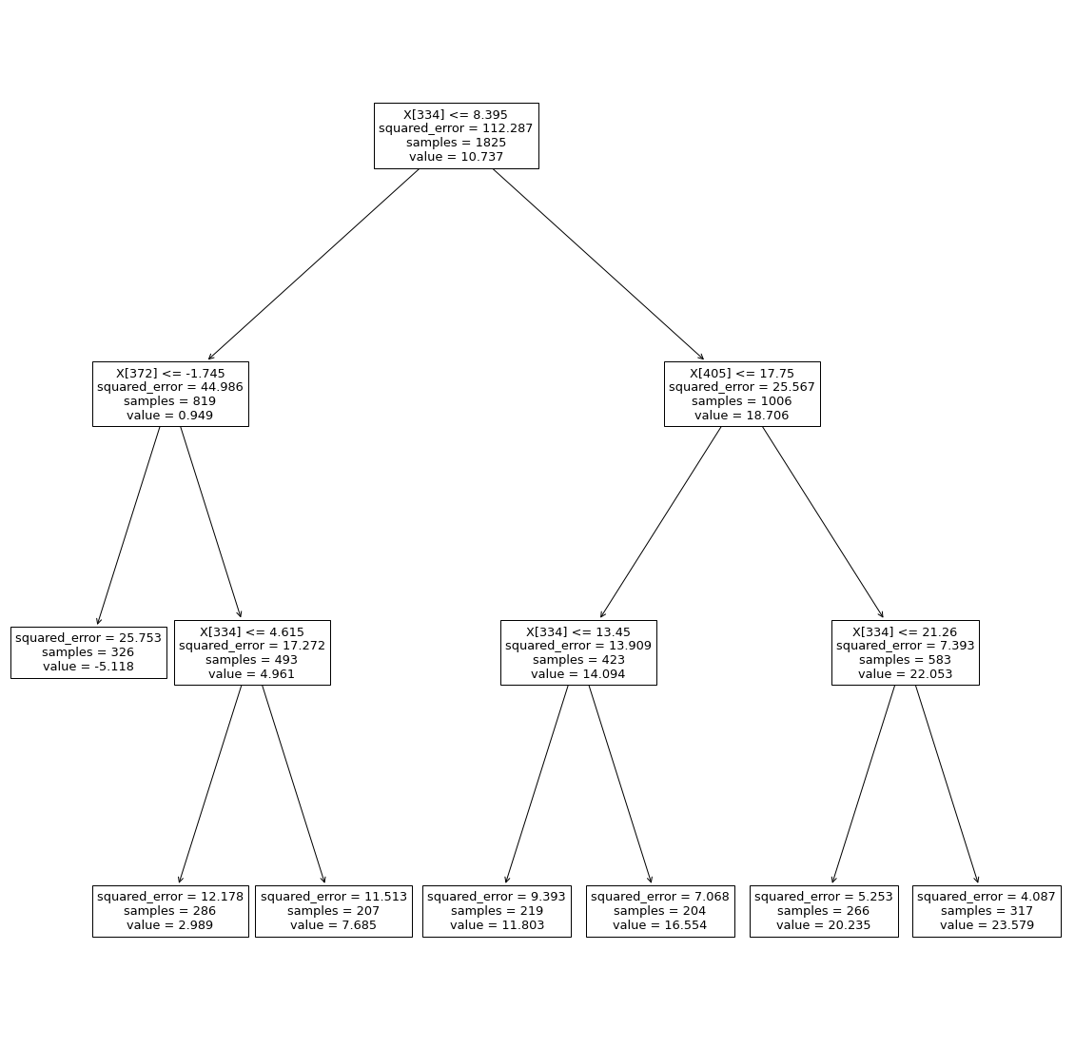
Regression Tree for Temperature Prediction
Min leaf size: 200
RMSE= 3.42
R²=0.88
Chicago, yesterday
Milwaukee, yesterday
Grand Rapids, yesterday
Chicago, yesterday
Chicago, yesterday
from sklearn import tree
from sklearn.tree import DecisionTreeRegressor
model = DecisionTreeRegressor(random_state=0, min_samples_leaf=200)
model.fit(x_train, y_train)
y_pred = model.predict(x_val)
tree_rmse = np.sqrt(np.mean((y_pred-y_val)**2))
tree_mae = np.sqrt(np.median(np.abs(y_pred-y_val)))
print('LR: RMSE={}, MAE={}'.format(tree_rmse, tree_mae))
print('R^2: {}'.format(1-tree_rmse**2/np.mean((y_pred-y_pred.mean())**2)))
plt.figure(figsize=(20,20))
tree.plot_tree(model)
plt.show()
for f in [334, 372, 405]:
print('{}: {}, {}'.format(f, feature_to_city[f], feature_to_day[f]))

Slide 39
Classification/Regression Trees Summary
Key Assumptions
Samples with similar features have similar predictions
Model Parameters
Tree structure with split criteria at each internal node and prediction at each leaf node
Designs
Limits on tree growth
What kinds of splits are considered
Criterion for choosing attribute/split (e.g. gini impurity score is another common choice)
When to Use
Want an explainable decision function (e.g. for medical diagnosis)
As part of an ensemble (as we’ll see Thursday)
When Not to Use
One tree is not a great performer, but a forest is

Slide 40
Things to remember
Decision/regression trees learn to split up the feature space into partitions with similar values
Entropy is a measure of uncertainty
Information gain measures how much particular knowledge reduces prediction uncertainty

Slide 41
Thursday
Ensembles: model averaging and forests

